Slide 1
成功典范文书点评
GGU Consulting 2017

Slide 2
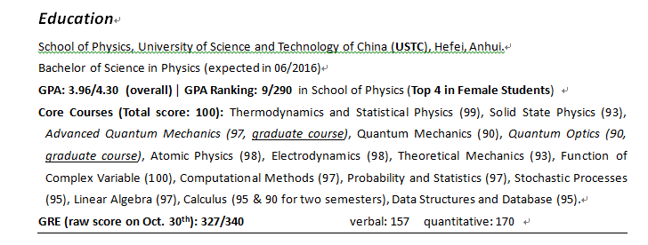
CV/Resume 01 物理学

Slide 3
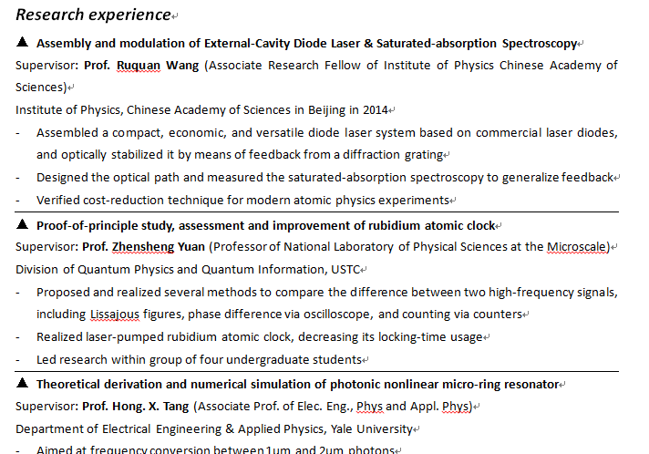
CV/Resume 01 物理学

Slide 4
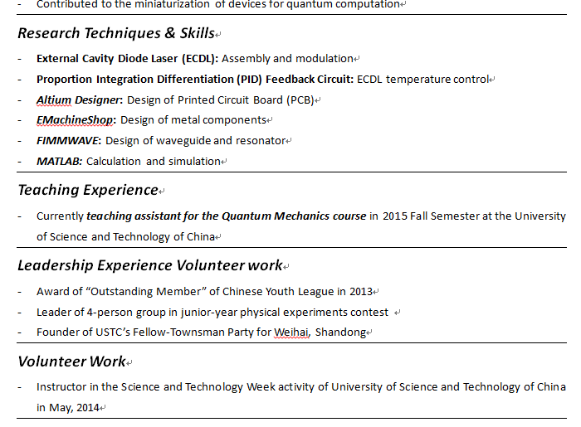
CV/Resume 01 物理学

Slide 5
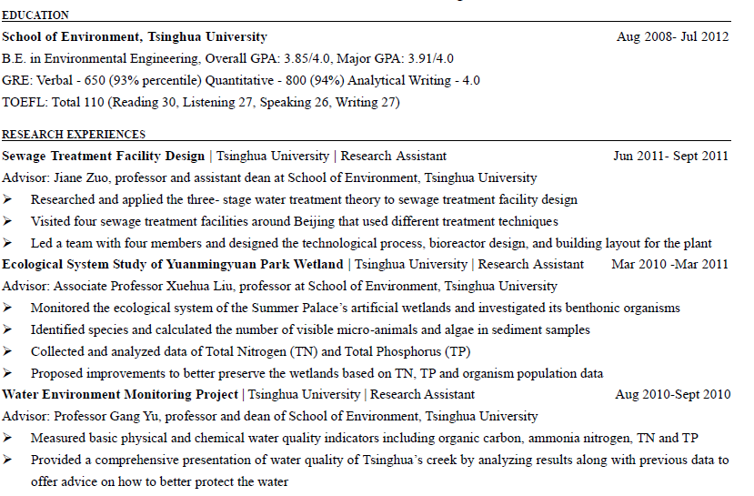
CV/Resume 02 环境工程（硕士）

Slide 6
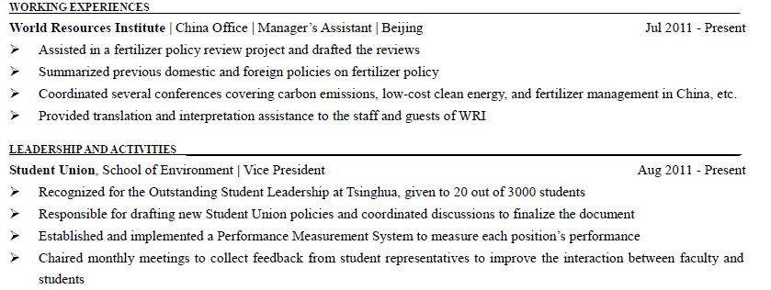
CV/Resume 02 环境工程（硕士）

Slide 7
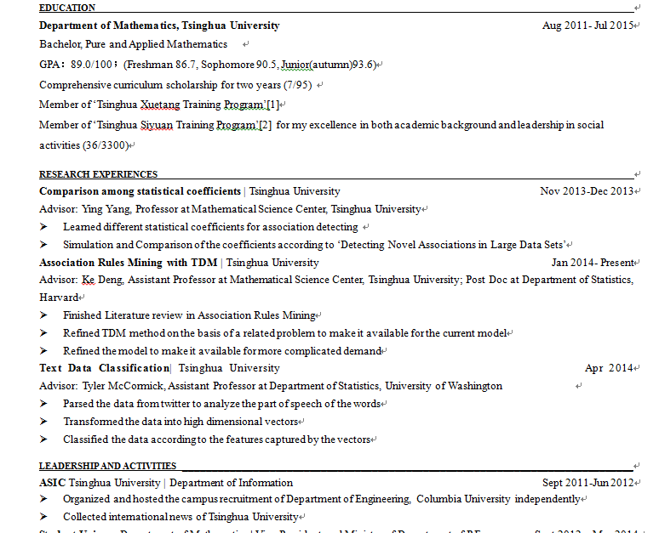
CV/Resume 03 统计博（暑研前）

Slide 8
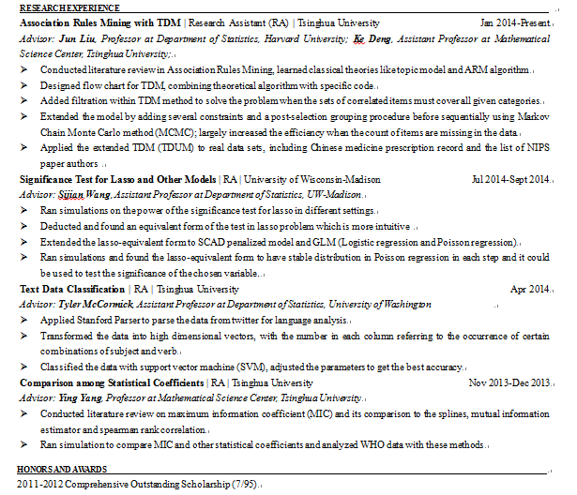
CV/Resume 03 统计博（暑研后）

Slide 9
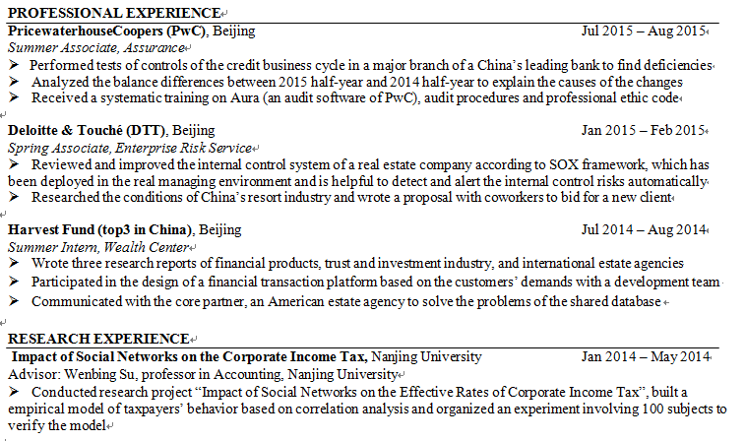
CV/Resume 04 会计硕士

Slide 10
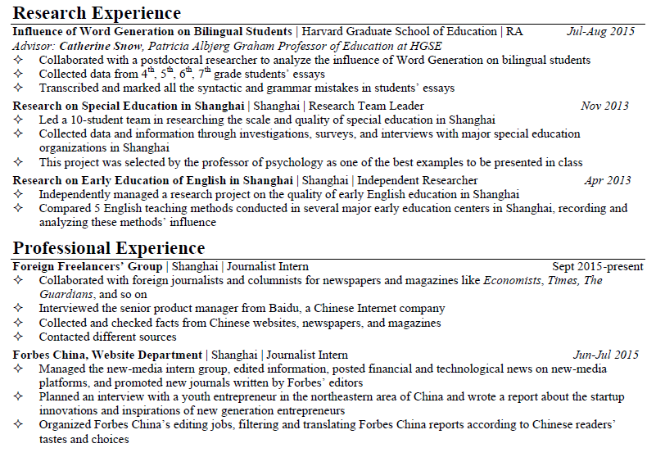
CV/Resume 05 教育硕士

Slide 11
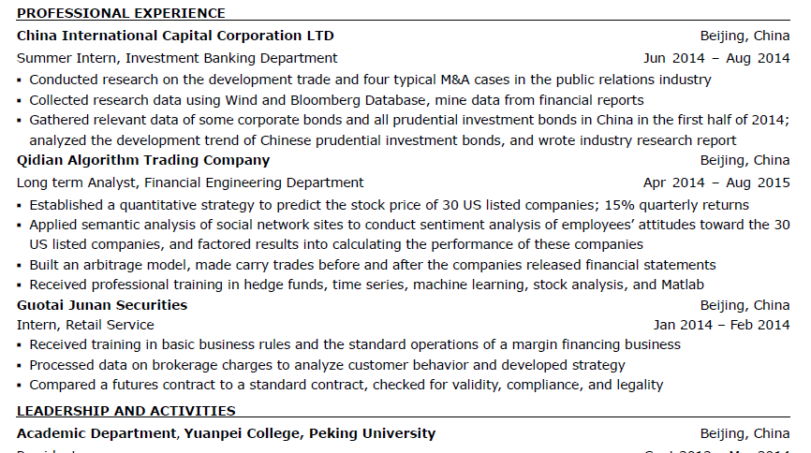
CV/Resume 06 金工/金融 （硕士）

Slide 12
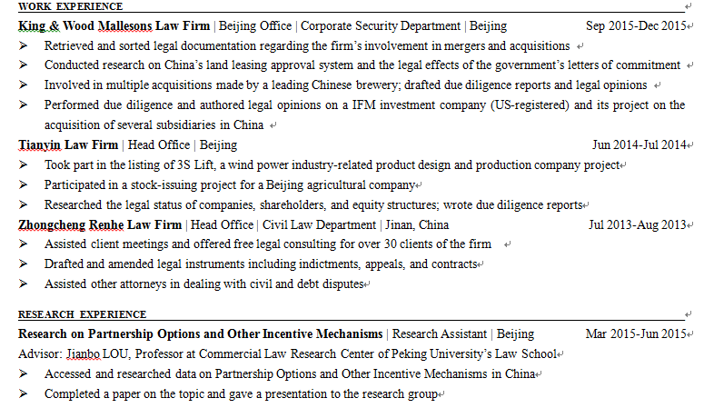
CV/Resume 07 法律硕士LLM

Slide 13
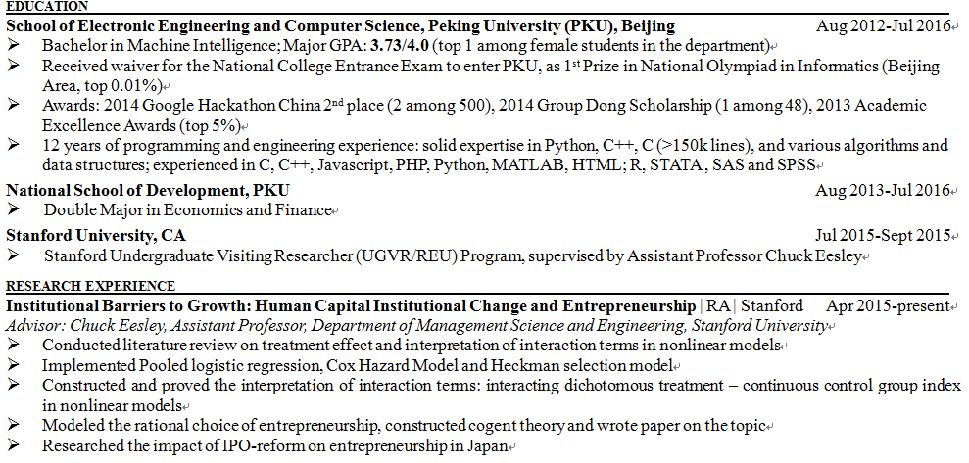
CV/Resume 08 商学院博士（OM/OR/CS/Stat）

Slide 14
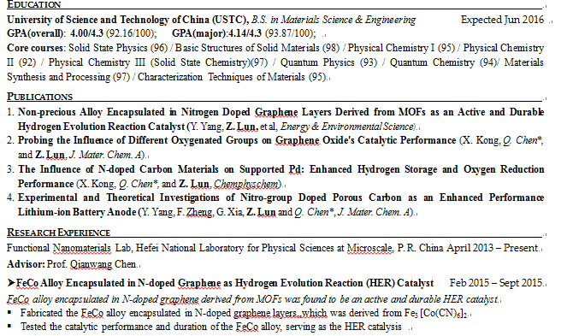
CV/Resume 09 材料/化学

Slide 15
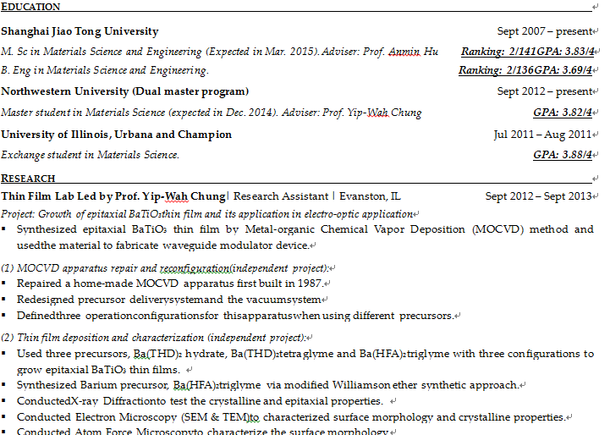
CV/Resume 10 机械工程博士

Slide 16
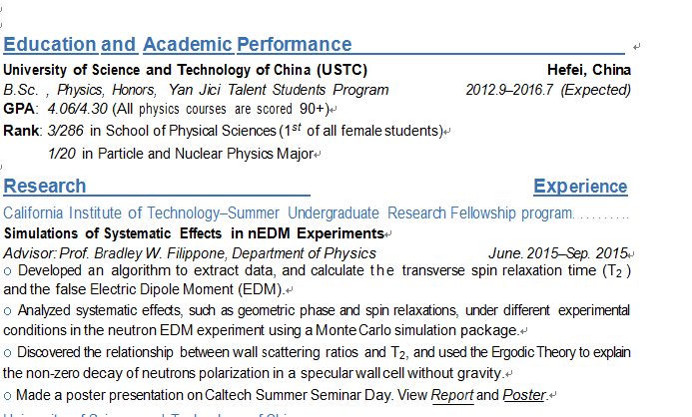
CV/Resume 11 物理学博士

Slide 17
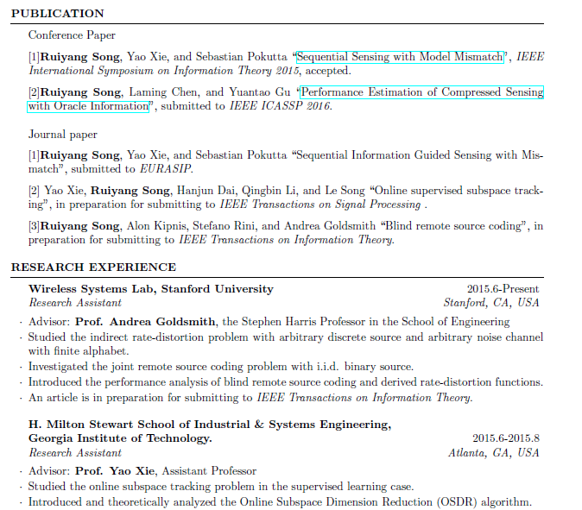
CV/Resume 12 EE博士

Slide 18
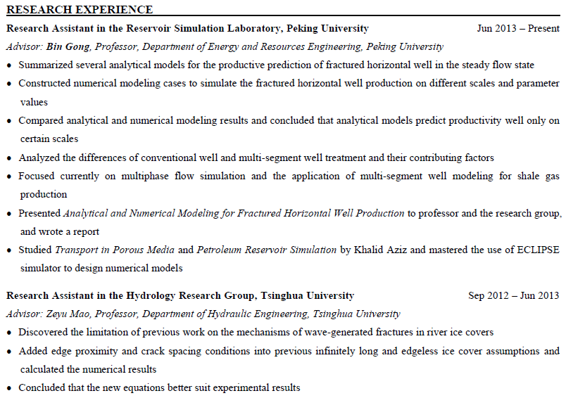
CV/Resume 13 石油/能源/机械博士

Slide 19
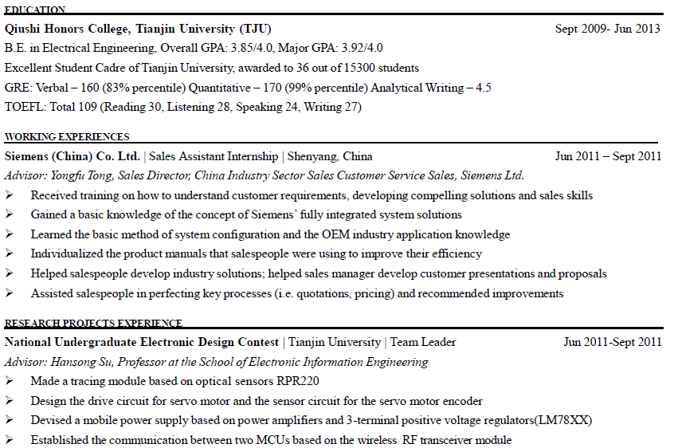
CV/Resume 14 EE Master

Slide 20
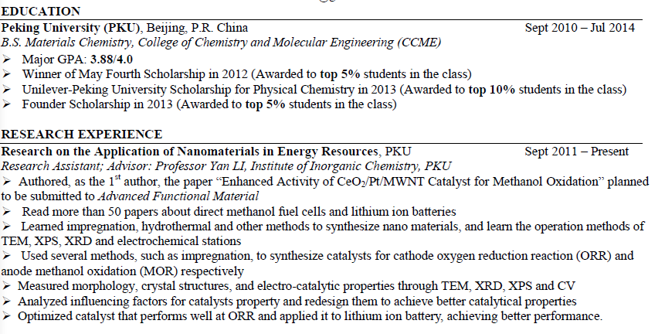
CV/Resume 15 化学工程硕士

Slide 21
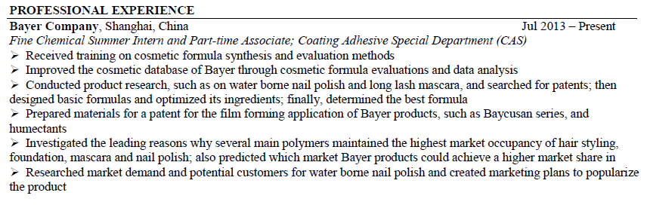
CV/Resume 15 化学工程硕士

Slide 22
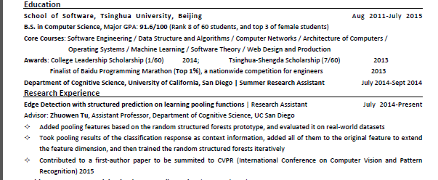
CV/Resume 16 CS硕士

Slide 23
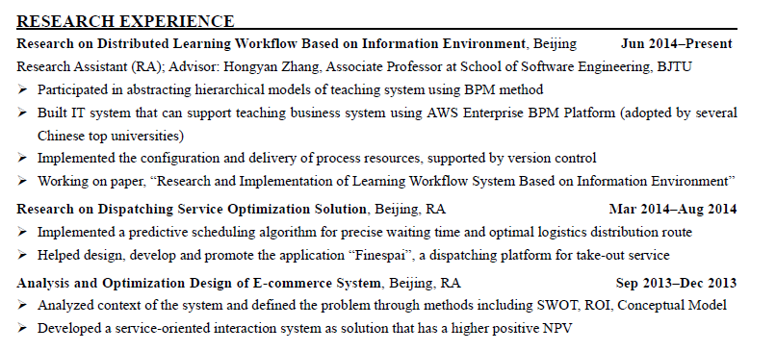
CV/Resume 17 CS硕士（无科研）

Slide 24
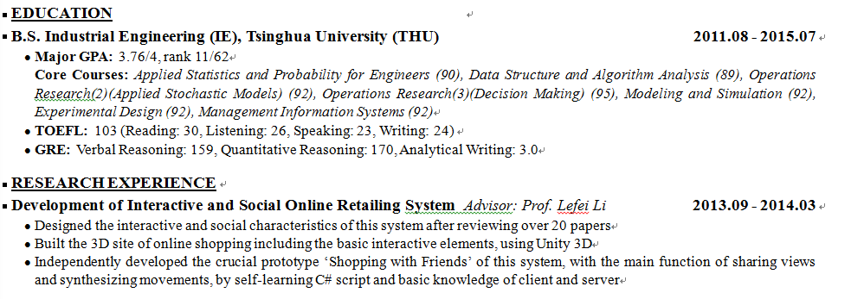
CV/Resume 18 Data Science硕士

Slide 25
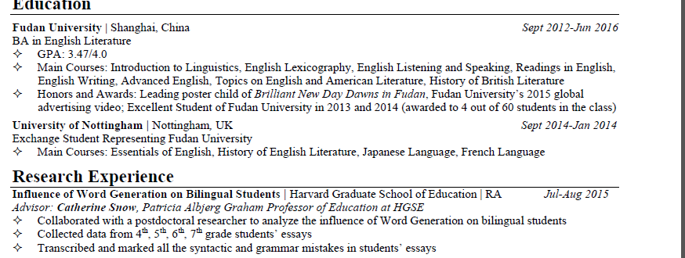
CV/Resume 19 教育学硕士

Slide 26
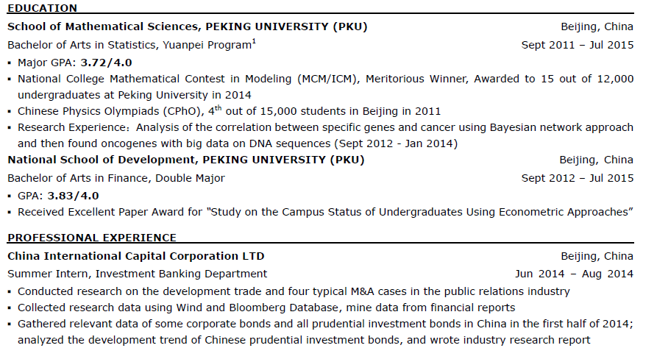
CV/Resume 20 金工+统计

Slide 27
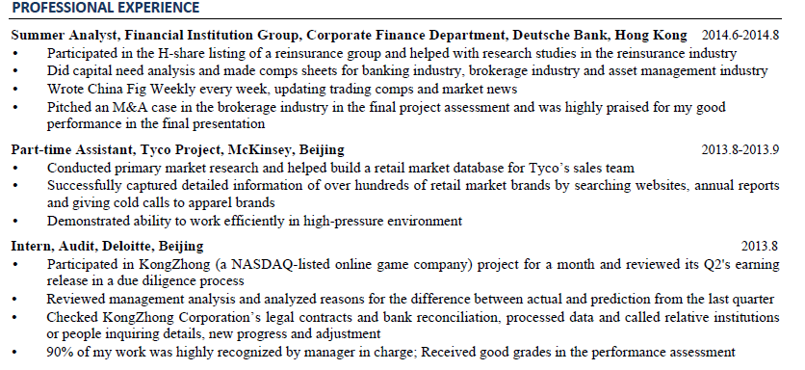
CV/Resume 21 金融（纯）硕士

Slide 28
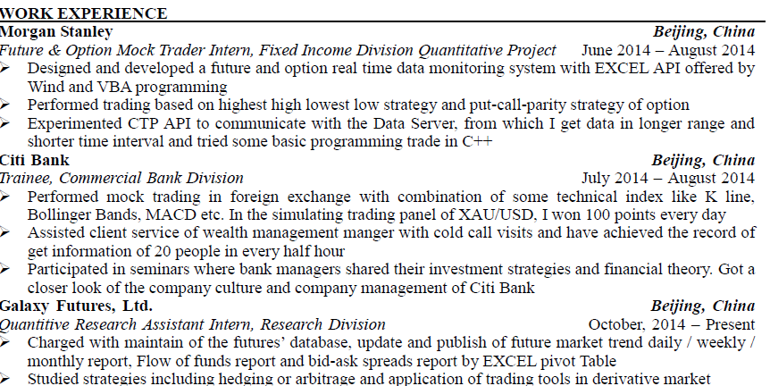
CV/Resume 22 MFE

Slide 29
推荐信 01 理工博士/硕士/外国教授“亲笔”
My name is Jianren Tui, I am a Professor and Director of Molecular Imaging Instrumentation Laboratory at Stanford. In summer 2013, Mr. Tongxue Zhang came to our department through a program, Undergraduate Visiting Researcher (UGVR/REU) Program, and worked under my supervision. I would say that Tongxue ranks Top 1% in all undergraduate students that I supervised in these 10 years. Thus, I strongly recommend him to your program for further study.
Every year, the UGVR program enables several best Chinese senior undergraduates to study with Stanford faculty members in research. Tongxue was the only Chinese student that was enrolled in my department and I am really impressed by his outstanding work and pleased to have him on our group this summer.

Slide 30
推荐信 01 理工博士/硕士/外国教授“亲笔”
He mainly focused on the image enhancement of a high resolution PET camera through detector misalignment correction. He was the first one who finished a comprehensive and in-depth study on this problem. He conducted great amount of work independent including 1mm-resolution PET camera simulation, signal processing and fast image reconstruction using GPU. One of his great work impressed me is that he proposed an inspiring idea of estimating the inter-panel misalignment and correcting the image distortion correspondingly. He independently realized the algorithm and validated it in experiments. His innovative algorithm can help to compensate the image distortion in the existing system and significantly improve the image quality with much higher resolution and SNR. His work greatly contributed our study and the manuscript about this work is in preparation.
Tongxue is also a good contributor to other projects in my research group. Tongxue’s work was based on part of the work conducted three senior members in my group. Right after arriving, Tongxuehas kept frequent communication with the three people. With the efficient collaboration, Tongxue caught the whole picture and found a good starting point of his work in 2 weeks. My group members told me that Tongxue was open to share his opinions with others, which contributed to various research projects.

Slide 31
推荐信 01 理工博士/硕士/外国教授“亲笔”
In addition, Tongxue showed critical thinking and creativity in his research. Tongxue didn’t just follow our ideas, but was able to think out of the box and propose new ideas independently. For example, in his work, he not only used derenzo phantom to evaluate reconstructed image in a traditional way, but also innovatively introduced a benchmark phantom to better measure and amend misalignment effect, which subtly simplified complex problems and made the follow-up work more efficient.
Mr. Tongxue Zhang left me with a deep impression. We appreciate his participation and contribution. He did a truly outstanding job on his project. From his time with us, I have 100% confidence that Mr. Zhang will be a successful researcher in the future. Your favorable consideration of his application would be most appreciated. If you have any questions, please do not hesitate to contact me.

Slide 32
推荐信 02 理工博士/硕士/外国教授“亲笔”
My name is Jianren Tui. I am the Professor and Chair of the Department of Civil and Environmental Engineering, University of Southern California. In summer 2011, Mr. Tongxue Zhang came to our department and worked under my supervision. During the six-week internship, his qualities of intelligence and diligence, strong desire for knowledge and good communication skills left me with a deep impression. I am pleased to recommend him sincerely to your department for further study.
The summer research program is a cooperation project between Viterbi School and top Chinese universities. The program enables Chinese seniors to study with USC faculty members. Only the most outstanding students get an opportunity to participate. Mr. Zhang was the only student that was enrolled with our department. The main impression he left with me was that of his intelligent and hard-working character. He assisted me on the Seismic Design of California’s High-Speed Rail program (CA HSR). I arranged for him to perform a review of seismic design and construction of HSR in different countries, and to analyze the main ideas of Chinese design code. Both tasks required much effort and a thorough comprehension of the subject material. Mr. Zhang did it very well. I was able to observe his progressive understanding of geotechnical earthquake engineering through our weekly discussions. This was also apparent in his research and thinking in the final presentation. I appreciated his fresh insights and hard work.

Slide 33
推荐信 01 理工博士/硕士/外国教授“亲笔”
Mr. Zhang has a hunger for knowledge. He always approached topics with a comprehensive outlook during the research process and made efforts to learn more about them as we progressed. When studying the Chinese design code, he found the response spectra to be a key concept, and then calculated the spectral acceleration in certain regions along the CA HSR. He also researched literature about Urgent Earthquake Detection and Alarm Systems, which he thought might help to increase the safety standards of the CA HSR. We also discussed the possible applications of this system in Japan and Taiwan. This research went beyond the range I had expected him to complete; furthermore, he did an outstanding job on those research topics. I believe his enthusiasm to search for knowledge will help him to be an excellent researcher in the future.
Besides, Mr. Zhang has good communication skills. He seized every opportunity to communicate with, me as well as with my students. In our weekly seminars, he was able to clearly present his research ideas, progress and future work. In addition, we often had in-depth discussions concerning a number of questions. His spoken English is very good. We were able to communicate on both a working and abstract level. Mr. Tongxue Zhang left me with a deep and unique impression. I think he has the scholarly potential to succeed in your program and I would like to recommend him. If you want more information, please contact me.

Slide 34
推荐信 03 纯上课的老师
I’m the head of, and a professor at, the Institute of Biomechanics and Medical Engineering at School of Aerospace, XXXXXX University. I would like to recommend Tongxue Zhang to your program. I taught Tongxue Zhang Elasticity and Frontiers of Mechanics and Engineering in the year 2010 and 2011. He often came to my office after class and talked with me about the knowledge learned from my courses, so I have had a very good chance to observe Tongxue’s performance. I would like to stress his diligence and excellent learning ability, as well as his intellectual eagerness and spirit of cooperation.
Tongxue is very diligent and has great learning potential. He always previewed future class lessons and took very detailed notes in every class. He would go over the notes after class and think in his own way, then write down the questions he encountered and discuss them with me. He always sat at the first or second row in class in order to get a chance to interact with me. In the final exam of both my courses, he got very high scores. Especially in Elasticity, he got a score of 93 out of 100. I believe that his diligence and excellent learning ability has created a solid foundation for him to begin to further his studies.

Slide 35
推荐信 03 纯上课的老师
Furthermore, Tongxue has always been eager to learn. He was never satisfied with just accomplishing the assigned homework. He often went to the library to learn more knowledge related to his major. I always arranged some homework at the end of my class, and he treated the assignments seriously. When he ran into difficulties regarding his homework, he never ignored them, but looked for relevant materials and consulted others for advice to ensure that he finished all his work accurately and punctually. Because of his desire for knowledge, he got a nickname “Academic Madman” from his classmates.
Last but not least, Tongxue was very kind and had a spirit of cooperation. He could get along with his classmates very well. Moreover, he was always ready to help others without hesitation. He not only made logical summaries and analysis about each unit I taught, but also shared his achievement with his classmates before the final exam, to help others get a better understanding of the course. He is such a cooperative young man, someone that everybody likes to get along with.

Slide 36
推荐信 03 纯上课的老师
In summary, his diligent and excellent learning ability, eagerness in learning and spirit of cooperation impressed me. Combined with my working experience, it’s no doubt that Mr. Tongxue Zhang will do a good job in your program. I ask that you look upon his application favorably and grant him a chance to study in your program. Your favorable consideration will be highly appreciated.
Yours sincerely,
XXXXXXXXXXXXXXXXXXX

Slide 37
推荐信 04 班主任+科研指导
My name is Jianren Tui. I am the Chair and Professor of the Department of Engineering Mechanics at XXXXXXX University. I am pleased to recommend Mr. Tongxue Zhang sincerely to your department for further study.
The first time I got to know Tongxue was when I invited several students to know the situation of the Tsien Mechanic class I charged in 2009. I learned that he was one of the most intelligent students in my class. At his sophomore year, I taught him Material Mechanics. At his junior year, he attended the Student Research Training (SRT) program I advised. The project he precipitated was focusing on non-adhesive micro gripper. Because of these contacts with him, I have a good chance to observe Tongxue’s performance and character.

Slide 38
推荐信 04 班主任+科研指导
Tongxue has a hunger for knowledge and research. He always approached topics with a comprehensive outlook during the research process and made efforts to learn more about them as we progressed. Tongxue attended group meeting every time and several times he worked in the laboratory till midnight. Even though he got some difficulties, he never gave up and tried different approaches to handle them. Once, he told me that he had a trouble in finding the two needed parameters in our theory model. Then I gave him an advice using experiment methods to find the parameter. He contacted an experiment teacher from Precise Instrument Department at XXXX Universityand invited the professor to share him relevant experience. After Tongxue’s endeavor and hardworking, he solved the problem. This research went beyond the range I had expected him to complete; furthermore, he did an outstanding job on those research topics. I believe his enthusiasm to search for knowledge will help him to be an excellent researcher in the future.

Slide 39
推荐信 04 班主任+科研指导
Besides, Tongxue has great communication skills and team work spirit. He seized every opportunity to communicate with, me as well as with other students. In our weekly seminars, he was able to clearly present his research ideas, progress and future work. In addition, we often had in-depth discussions concerning a number of questions. At the end of the course, Material Mechanics, I left the students a final project. I divided them into teams, and let them choose a mechanics problems that could be solved with material mechanics. Tongxue was the leader of his team. Under his lead, his team members cooperated well and did a good job. They spent a lot of time studying the honeycomb structure and investigated the feature of the hexagon structure in honeycomb. They also thought lots of ideas of the possible application of the hexagon structure in honeycomb. To my delight, Tongxue’s leadership potential is great.

Slide 40
推荐信 04 班主任+科研指导
This September, Tongxue was invited by Professor Yonggang Huang to participate in a research program at Northwestern University. Now he is conducting research in US. Although his SRT research at XXXX University had to be suspended, I think he would do a very good job in US.
In summary, Mr. Tongxue left me with a deep and unique impression. I think he has the scholarly potential to succeed in your program and give him my highest recommendation. If you want more information, please contact me.

Slide 41
推荐信 05 纯实习的上司的信
This is Jianren Tui from China International Capital Corporation Limited (CICC). I am the Manager Director of the Quantitative Analysis Team in Security Investment Department. Before this, I was the Executive Director in Morgan Stanley. Here I want to recommend Ms. Tongxue Zhang as a qualified candidate for your Master program on the basis of my 20-year service in the industry.
At the first time I met Tongxue, she showed strong enthusiasm towards financial engineering and quantitative analysis. During her internship, I assigned her a paper which is about the supervised adaptive group lasso method, asking her to try her best to understand the model and to run back test using the market data. The method used in the paper is quite challenging for an undergraduate student. However Tongxue managed to figure out the main idea of the model and programmed with Matlab to run the back test. When we discussed the result she got, she put forward several quite relative questions about the model and expressed her idea of how to further test the utility of the advanced model.

Slide 42
推荐信 05 纯实习的上司的信
In addition, I’m deeply impressed by Tongxue’s strong responsibility and working efficiency. During her internship, Tongxue was quite focused on her work and spared great efforts to figure out the problems she encountered. She considered questions in a rather comprehensive way in which she tried to test the model by using different data sets and specifications and compared the predictability of different models. She possessed rather strong ability of time management which is showed in her work and her presentation at the end of her internship.
Once she talked with me quite excitedly that she was really fascinated by how the academic knowledge can be effectively applied in the quantitative financial analysis and that she always hopes to involve in a job where she can applied what she learnt and her idea of the revolving mechanism in the world to tackling the real world problem. Her passion for the quantitative analysis and her unique characteristic as a strong determined and responsible person will undoubtedly benefit her future career. I definitely believe that she will go beyond any limit and strive to be a positive asset in your program. Therefore, I give my strongest recommendation for Ms. Tongxue Zhang. If you want more information, please contact me.

Slide 43
PS 01 所有博士+科研型硕士
II am applying for the PhD program of Electrical Engineering in Stanford University. In particu- lar, I am interested in working with Professor Andrea Goldsmith. My research interest focuses on the mathematical analysis of information theory, statistical signal processing, and their applications in communication systems
I have been a highly motivated researcher and an effective learner with outstanding academic perfor- mance. My GPA is 95 out of 100, ranking 1/240 in the Department of Electronic Engineering, Tsinghua University. Besides, during my exchange semester in School of Electrical and Computer Engineering, Georgia Tech, I had GPA 4.0/4.0 with A’s for all the five courses I took, including the graduate level class Stochastic Process I. The study of advanced mathematic and electronic engineering courses and the experience in several research projects advances my research skills and analytic ability, making me well prepared for the graduate study in the field of information processing systems.

Slide 44
PS 01 所有博士+科研型硕士
I am applying for the PhD program of Electrical Engineering in Stanford University. In particu- lar, I am interested in working with Professor Andrea Goldsmith. My research interest focuses on the mathematical analysis of information theory, statistical signal processing, and their applications in communication systems
I have been a highly motivated researcher and an effective learner with outstanding academic perfor- mance. My GPA is 95 out of 100, ranking 1/240 in the Department of Electronic Engineering, Tsinghua University. Besides, during my exchange semester in School of Electrical and Computer Engineering, Georgia Tech, I had GPA 4.0/4.0 with A’s for all the five courses I took, including the graduate level class Stochastic Process I. The study of advanced mathematic and electronic engineering courses and the experience in several research projects advances my research skills and analytic ability, making me well prepared for the graduate study in the field of information processing systems.

Slide 45
PS 01 所有博士+科研型硕士
The first research project I participated in was the performance analysis of sparse signal recovery, which was a Tsinghua Student Research Training program advised by Prof. Yuantao Gu. Random measuring matrices are widely used for compressed sensing and Bernoulli random matrix is popular due to the low computational complexity involved. Hence, it is interesting and important to analyze the robustness of the Bernoulli sensing system when perturbed by noise. This project focuses on the random coding of sparse signal with ±1 sensing matrix and optimal receiver under a complete noise model with the juxtaposition of matrix perturbation and measurement noise. The main challenge of this project is that the inverse of a Bernoulli random matrix does not have a closed form distribution. By applying theories in random matrices and compressed sensing, I derived lower and upper bounds for the mean squared error of sparse signal reconstruction which hold with high probability. This re- sult provides a probabilistic estimation of the performance of Bernoulli sensing system with optimal receiver as well as a lower bound for the average recovery error with arbitrary receivers. This work has been submitted to IEEE ICASSP 2016.

Slide 46
PS 01 所有博士+科研型硕士
Compared to random coding, sequential sensing is able to take advantage of the prior knowledge of the signal by updating the sensing strategy as the measurements proceed. Hence better recovery can be expected by applying sequential algorithms when such information is available. In practice, however, we usually do not know the exact signal model, and the adaptive sensing algorithms have to work on estimated and inaccurate parameters. It is then important though challenging to discover how the initial bias in the model information will impact the overall performance of sensing. The second research I conducted focused on the theoretical analysis of sequential sensing. Under the guidance of Prof. Yao Xie and Prof. Sebastian Pokutta in School of Industrial and Systems Engineering, Georgia Tech, I studied the performance of the Info-Greedy algorithm which adaptively senses Gaussian and Gaussian mixture models when the initial parameters are biased. By applying methods in information theory, stochastic process, and matrix perturbation theory, I derived the performance bounds of infor- mation guided sensing with model mismatch. This work shows the additional power and number of measurements required due to mismatch, presenting the robustness of the particular adaptive sensing method. Part of this work has been accepted by and presented at IEEE International Symposium on Information Theory 2015, and we have also submitted a journal paper to EURASIP.

Slide 47
PS 01 所有博士+科研型硕士
In Summer 2015, I visited the Wireless Systems Lab at Stanford and conducted research on remote source coding and rate-distortion theory advised by Prof. Andrea Goldsmith. Specifically, I analyzed the rate-distortion trade-off when the underlying source is observed indirectly through multiple noisy parallel channels. The primary challenge of this problem is the difficulty in deriving the closed-from so- lution of the rate-distortion function for non-Gaussian source coding problem. In his project derived the indirect rate-distortion function (iRDF) for binary source observed through multiple binary symmetric channels and multiple binary erasure channels. Besides, I proposed the blind source coding problemwhen the encoder-decoder system is unaware of the existence of the underlying remote source and the encoder will regard the observed process as the source. An estimator cascaded to the decoder which possesses the knowledge of the true source and the noise channels recovers the source based on the output of the decoder. Blind coding scheme is sub-optimal in general since an optimal coding strategy for remote source would take advantage of the information of the channels. Hence, the rate-distortion trade-off for blind coding serves as a lower bound for the rate-distortion function and the gap can be zero for certain cases. In particular, the blind joint coding system provides an inner bound for the iRDF of joint encoding and the blind separate coding provides a lower bound for the iRDF of separate encoding or the CEO problem. This work will be submitted to IEEE Transactions on Information Theory and IEEE ISIT 2016 shortly.

Slide 48
PS 01 所有博士+科研型硕士
During my visit at the Wireless Systems Lab, I got deeper understanding of and insights into the field of source coding and information theory as a whole. I find myself sharing many common research interests with Prof. Goldsmith and am looking forward to continuing to work with her. For the source coding problem, for example, I would like to address the following problems as a first step of graduate research:
• Rate-distortion tradeoff for iid discrete sources in general. The previous study for remote source coding with multiple observations has focused on the case with binary source and identical noise channels. An interesting generalization of those works is to analyze the case with an arbitrary iid discrete source observed through arbitrary parallel discrete channels. Due to the difficulty in deriving closed-form solutions, I am planning on applying blind coding strategies again for this setup and derive the rate-distortion trade-off estimation through optimization.

Slide 49
PS 01 所有博士+科研型硕士
• Sampling strategy for continuous-time sources. If we need to compress a continuous-time source pre-sampled under sub-Nyquist rate, it is necessary to design a good sampling strategy. For Gaus- sian sources, an optimal scheme can be decided for a given frequency with the power spectrum density provided. A natural and interesting case following this result is to analyze the impact of inaccurate density. Given the duality between source coding and channel capacity, I am plan- ning on applying results on random matrices to study the sampling of a Gaussian source whose spectrum density consists of multiple sub-bands. This is likely to lead to a minimax result of the rate-distortion function which will be an important dual conclusion of the channel capacity results previously introduced by Prof. Goldsmith’s group.
Based on my experience during undergraduate study and the considerations above, I am very interested in working with Prof. Goldsmith for graduate research and confident in contributing to the progress of the research on information system and theory at Stanford.

Slide 50
Essay 各种
•01 Columbia MPA
1. Personal Statement Please elaborate on why you have chosen to apply to the MIA/MPA program. How will this program enable you to achieve your career goals? Describe your academic and research interests and career objectives. (400 words maximum)* 2、SIPA Interest Tell us about a SIPA professor or practitioner you would like to work with and why. (200 words maximum)* 3. Second Essay What one policy (national or local) would you create or change and why? (200 words maximum)*

Slide 51
Essay 各种
•02 Uchicago MPP
1. Motivation Statement (maximum 300 words)
Why public policy? Why Chicago Harris?
2. 1）If you become a member of the University of Chicago community, what do you plan to do in your spare time?
2) You’re interviewing for your dream job post Chicago Harris. How will you distinguish yourself from other policy graduates?

Slide 52
Essay 各种
•03 Columbia Business School MSFE
1. Essay 1
In 250–500 words please describe your educational goals and those academic and/or professional achievements which have contributed most to your development.
2. Essay 2
In 250–500 words please indicate your expected career track (examples include, but are not limited to, consulting, banking, asset management, research and modeling, risk management, etc.) and describe how the Master of Science in Financial Economics will help you attain your career goals. Please be specific.

Slide 53
Essay 各种
•04 NYU MPA
1. Essay 1 "Public service is the highest good, and, when done honorably and well, the most rewarding." The ideals expressed in this quote by former New York City Mayor Robert F. Wagner embody the passion, integrity, and commitment of the NYU Wagner community. Tell us about yourself, and in doing so, describe the specific values, experiences, and accomplishments that have shaped who you are and led you to pursue a career in public service. (Maximum 500 words) 2. Essay 2 Public service professionals face tremendous challenges both in and out of the workplace. Resilience and strength of character are vital characteristics for success in any facet of public service. Describe a challenge you encountered in your personal, professional, or academic life. How were you tested? What actions did you take to overcome the challenge? (Maximum 500 words)

Slide 54
Essay 各种
•05 Boston College MSA
Personal Essay: Please discuss how you plan to achieve your short and long term career goals. What challenges will you face and how will you leverage your academic and professional experiences to achieve these goals?

Slide 55
Ten Interview Questions and Common Mistakes
1. Introduce Yourself
This question is an opportunity for you to highlight your most important experiences, qualities, and goals. It is not the time for you to read through your resume or talk about everything you have done. You should have a structured answer focused on connecting you as an individual to the program you are applying for. Feel free to mention your hobbies at the end, but you do not need to do that.
2. What are your strengths?
To properly answer this question you should highlight at least 3 things that make you unique and that define you well. You can mention adjectives, like enthusiasm, hard-working, persistent, or skills, like C++, mathematics, or leadership. Make sure you explain each one in detail and try to include at least one story related to one quality. Finally, structure your answer so that you first state the strengths, then explain the strengths, and then summarize.

Slide 56
Ten Interview Questions and Common Mistakes
3. What are your goals?
For this question, you must have clearly articulated goals. Feel free to name companies, job titles, responsibilities, and locations. But, the most important part is explaining WHY you want to do these things. Usually, you have already mentioned the goals in the personal statement, so this question is asked so you can highlight why you want to do those things.
4. Why this program?
For this question, you need to be prepared with specific things that interest you. If you can recite course names or professor names, you will really show your strong interest in the program (but, please don’t name a course that is offered by every single program in the field). You should also be able to mention things specifically on the program’s website. Feel free to state back the words just as they appear on the program website. Again, three factors are usually sufficient for answering this question and structure is important. Also feel free to mention what you hope to gain from the program in terms of skills and opportunities.

Slide 57
Ten Interview Questions and Common Mistakes
5. Do you have any questions for me?
Do not ask how many people will be admitted or when you will find out. Instead this question is an opportunity for you to again highlight your interest in the program. You should do some research on the website of the program and ask about a specific course, curriculum design, program, seminar, or opportunity highlighted on the website. You can even start the question with, “I read about X on the website, I am wondering . . .”
6. Tell me about a challenging internship and what you’ve gained?
This type of question is difficult because it has two parts. You should first set the scene with the internship name and responsibility. Then tell a specific story about the challenge and how you addressed it. Then you can tell what the lesson is and mention why is will be useful for you in the future.

Slide 58
Ten Interview Questions and Common Mistakes
7. What qualities make you fit for our program?
At first glance, this question seems a lot like “what are your strengths?” And, in many ways it is. You should strive to have a strong structure and mention three things with explanations. But, you have an added task of connecting those things to the program. Imagine the interviewer is comparing you and one other candidate, what are the aspects of your personality or experience that will set you apart from the other candidate? Those aspects should be what you highlight for this answer.
8. Why study X?
Again, for this answer, structure is very important. One mistake people often make is just saying, “I am passionate about X” or “X delights me”. If you say that you are passionate about it, then you need to tell me why. What about it is so interesting? For this answer, you should have around three details, if possible. Try to connect your answer to an internship experience or classroom experience. Also, feel free to tell a story about what led you to X. The worse thing you can do is only say, “I want to do X because my parents do X.”

Slide 59
Ten Interview Questions and Common Mistakes
1. The surprise question.
Sometimes the interviewer viewer will ask a question that you did not prepare for, like “Tell me about your biggest mistake in life.” If this happens, you should still answer the question, but take a few seconds to think of an answer. If it will take you a while to think, then say, “That’s a great question! Let me think about it for a second.” Then you can take a brief pause to prepare an answer, instead of just saying “uhhhhh”.
2. Is there anything else you want to tell me?
This is the most difficult question that sometimes appears at the end of the interview. If there is something you feel like the interviewer missed like a great skill you didn’t highlight, a cool internship experience you want to tell, or something you didn’t say, then this is the time to say it. Most of the time, you will have nothing to add. So, you should say something like “this interview and the application were pretty thorough. There’s nothing I would like to add at this time. Thanks so much for taking the time to interview me” and then add a quick sentence about why you would like to go to that program.

Slide 60

Q&A

